Slide 1

Transformers: Under the Hood of LLMs
ADS 5535 – Deep Learning & Generative AI
Brian Mayer

Slide 2






Who Am I?
Bachelor & Masters in
Industrial & Systems Engineering
Bachelor & Masters in
Industrial & Systems Engineering
Logistics, Manufacturing, & Performance Analysis
Logistics, Manufacturing, & Performance Analysis
Transportation Research
Transportation Research
Research Management: Intelligence, NLP, and Forecasting Research
2

Slide 3






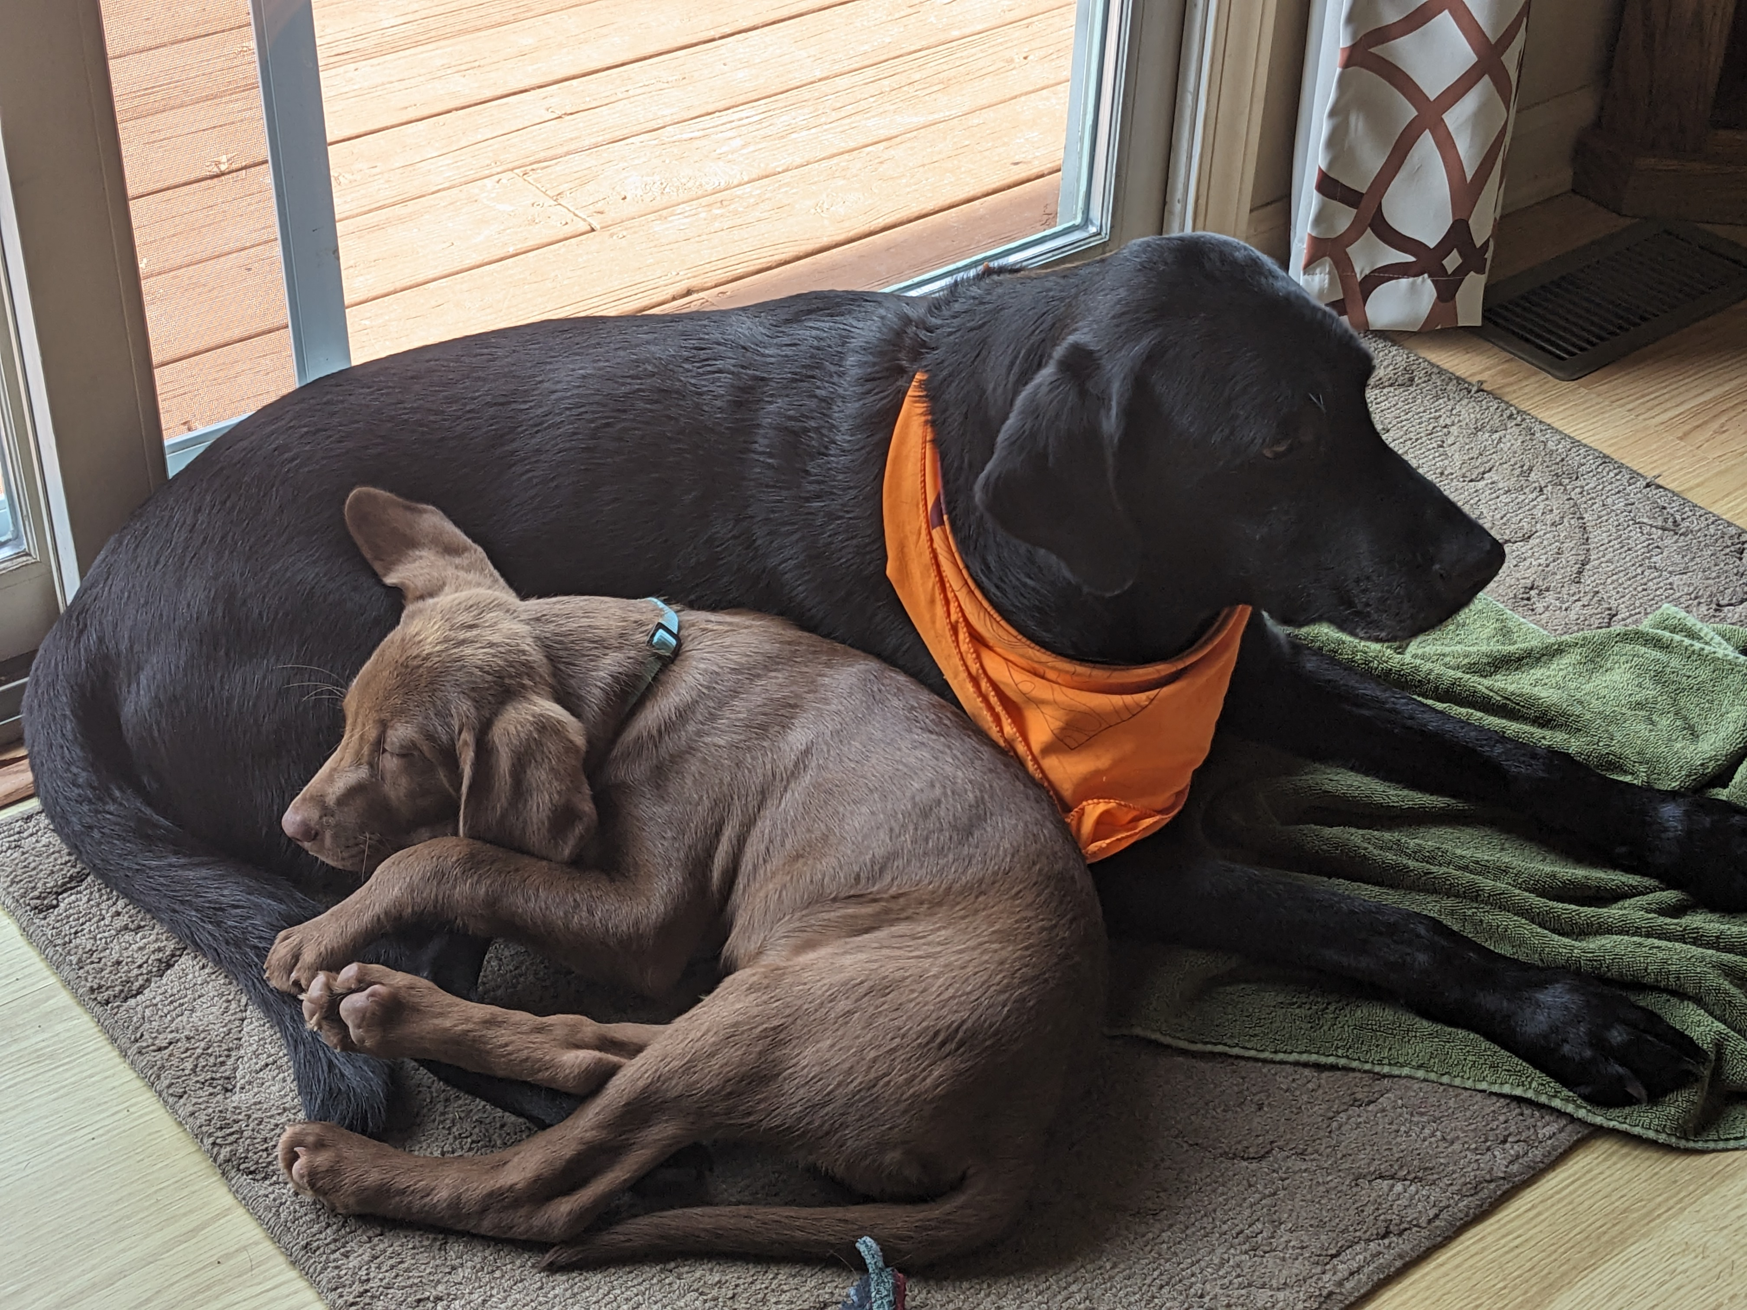
Who Am I?
3

Slide 4
ADS 5535 – Deep Learning & Generative AI
Neural Networks
Embeddings
CNN – Images
RNN – Text and other
Reinforcement Learning
Generative AI
Transformers
Large Language Models
Development
Evaluation
Use
Course Progress
Theory
Applications
Considerations
4

Slide 5
Motivating Question

Slide 6

Inspiration
Last word = “book”
Try to predict the rest of the words in the sentence
How do you know which it should be?
“… I read was “The Hatchet” by Gary Paulsen.”
“… the criminal and then take them to the jail cell.”

Slide 7
Review

Slide 8
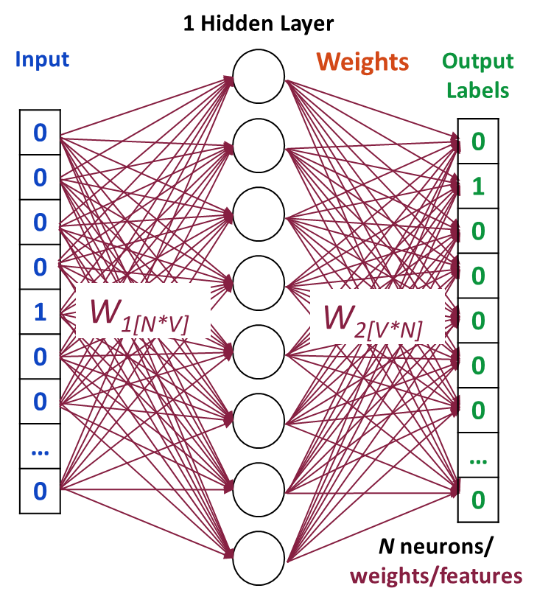
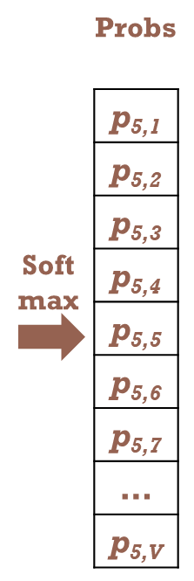

(Word) Embeddings
Train a single-layer NN to predict the next word
Use the weights not the output of the network as the embedding
If words frequently appear together (i.e., have similar contexts)
THEN
Our model needs to output similar results for the 2 words
THEREFORE
Their hidden layers (word vectors) will be similar
(i.e., relationally close in an n dimensional space where n is the number of weights/features)

Slide 9
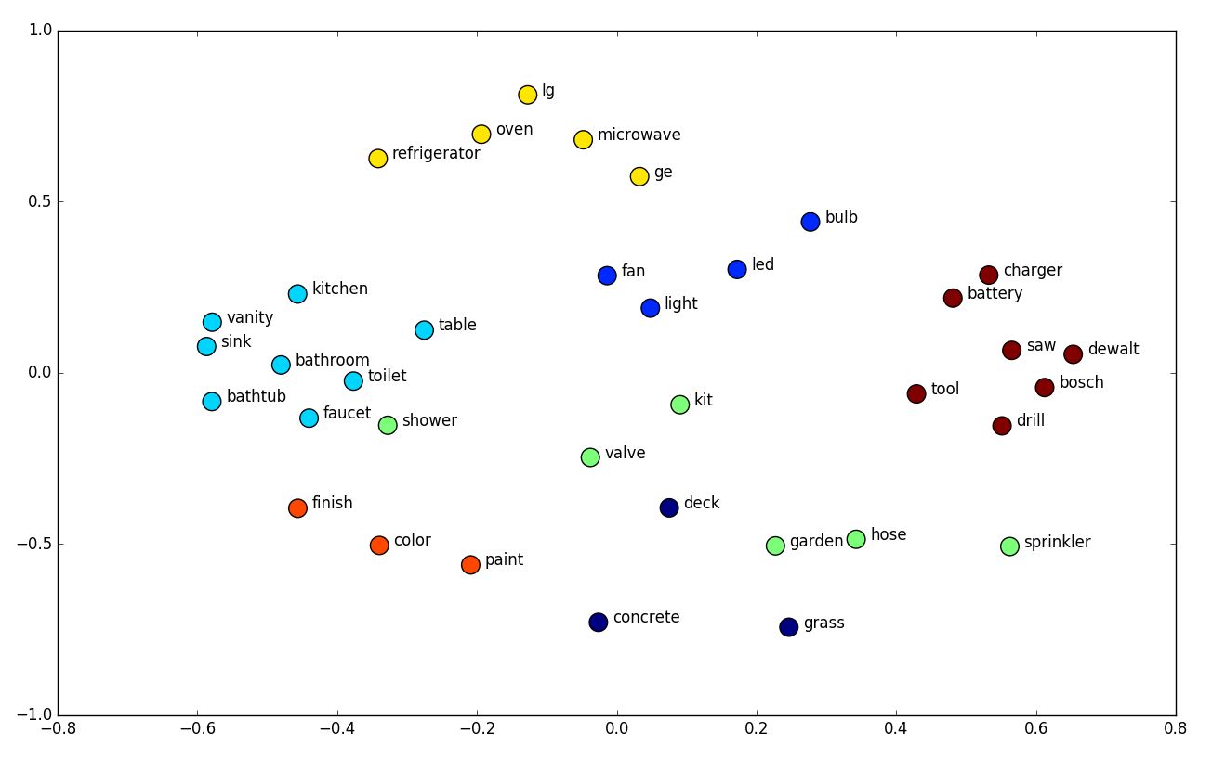
Comparing (Word) Embeddings
Using Cosine Similarity
Measures the similarity between two non-neg vectors by calculating the cosine of the angle between them
Cos (0 deg) = 1 => the same
Cos (90 deg) = 0 => orthogonal
(no similarity)
Using, e.g., MDS
$$\cos\left(θ\right)= \frac{A∙B}{\left\|A\right\|\left\|B\right\|}$$
Dot
Product
Cosine Similarity doesn’t consider magnitude (e.g., for when comparing docs of different length)
Dot Product considers magnitude
(e.g., for when vectors are already normalized)
https://neptune.ai/blog/word-embeddings-guide
9

Slide 10
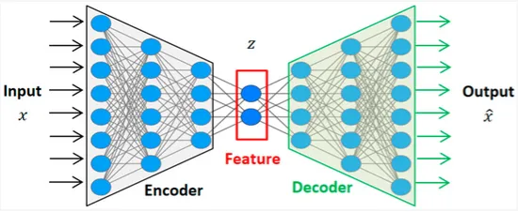
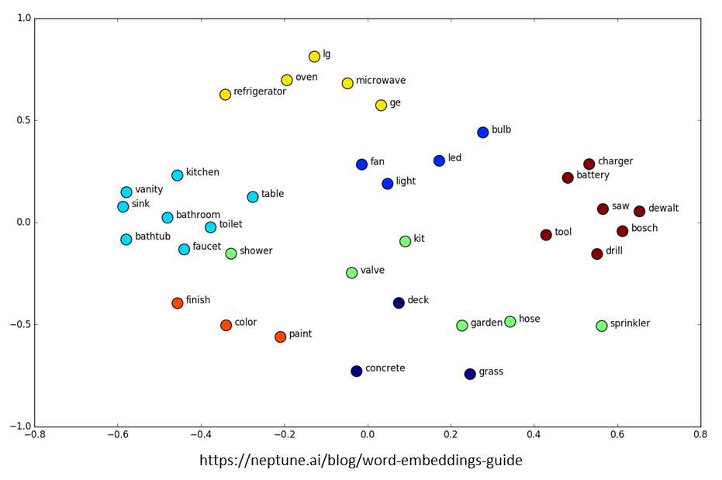
Generative AI Review
Variational Autoencoders
Encode (or compress) a huge amount of unstructured, unlabeled training data (distributions) into a smaller set of parameters
Embeddings (w/ many layers decreasing in size)
Latent space (Semantic space)
Decode those parameters to reconstruct the content or create new content
NN layers increasing in size
For example, decode “random” samples from our visualization of word embeddings (i.e., latent space)?
Those “locations” (vector values) hold “meaning”
?
?
Can work on any data, not just words

Slide 11
Supporting Theory (LLM Development)
Large Language Models (LLMs) evolved from:
Embeddings (e.g., word2vec)
Generative AI^{1,2,3}
RNNs/LSTMs/Variational Autoencoders
ELMO⁴: dynamic word embeddings
Transformer Architecture w/Gen AI^{5,6}
Embeddings change based on context
GPT1⁷
Generative
Pre-Trained
Transformer
Cho, Kyunghyun, et al. "Learning phrase representations using RNN encoder-decoder for statistical machine translation." arXiv preprint arXiv:1406.1078 (2014).
Sutskever, I., Vinyals, O., & Le, Q. V. (2014). Sequence to sequence learning with neural networks. Advances in neural information processing systems, 27.
Kingma, D. P., & Welling, M. (2013). Auto-encoding variational bayes. arXiv preprint arXiv:1312.6114.
Neumann, M. P. M., et al. "Deep contextualized word representations." arXiv preprint arXiv:1802.05365 (2018).
Devlin, Jacob. "Bert: Pre-training of deep bidirectional transformers for language understanding." arXiv preprint arXiv:1810.04805 (2018).
Vaswani, A. "Attention is all you need." Advances in Neural Information Processing Systems (2017).
Radford, Alec, et al. "Improving language understanding by generative pre-training." (2018): 3.

Slide 12
Attention & TRANSFORMERS
Vaswani, Ashish, et al. "Attention is all you need." Advances in neural information processing systems 30 (2017).

Slide 13
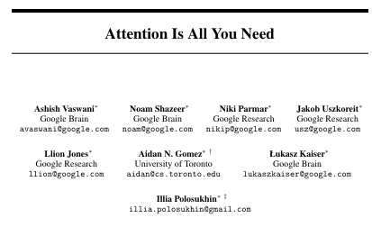
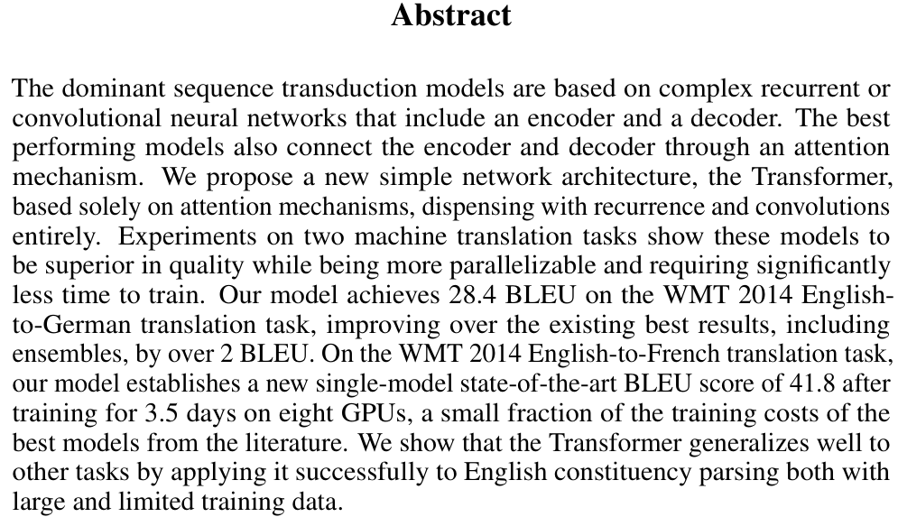
The Source

Slide 14
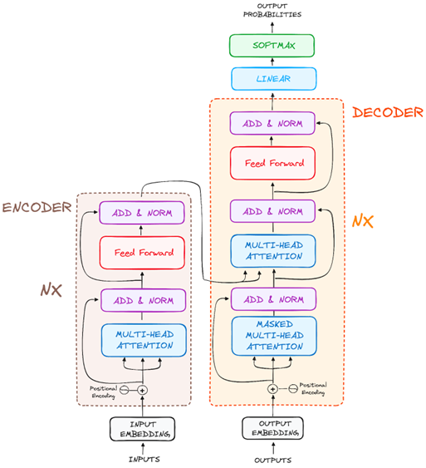
Transformers With Attention
Use a concept called self-attention mechanism and multi-head attention technique to determine and focus on what’s most important about data within a sequence.
Capture the context of a word:
Examine an entire sequence simultaneously, e.g.,
Words in different parts of a document
Frames at the beginning and end of a video
Decide how and when to focus on specific time steps of that sequence
Encode what they learn from training data into embeddings
Allow for computational parallelization
In contrast, RNNs process data in a serialized manner
One at a time, in a specific order
Hinders ability to capture long-range dependencies
LSTMs help
https://www.datacamp.com/tutorial/how-transformers-work

Slide 15
Transformer Steps
Ingest data
Tokenize data (break into small pieces, e.g., words)
Convert each token into a vector embedding
Add positional values to a token’s embedding
Remember transformers are not serialized
Transformer Blocks
Attention
Feed-forward NN
Softmax and Output
Outputs only the next token (iteratively)
https://www.datacamp.com/tutorial/how-transformers-work

Slide 16
Activity #1
Let’s try to understand some of those
steps intuitively first

Slide 17
Attention Activity #1
7 Cards: Numbers on one side and words on the other
Flip over card #1. This is our “query” word.
The other cards have words that appear around the query word.
What do we think our query word means?
A set of words? A punishment? To punish?
Could it help to turn over more cards?
Flip over card #2
Does this help us better understand the word?
How about card #3? #4?
What does judge mean? Verb? Noun? Aaron?
Turn over #5

Slide 18
What We Learned
Other words help us piece together the context
(But not all words equally)

Slide 19
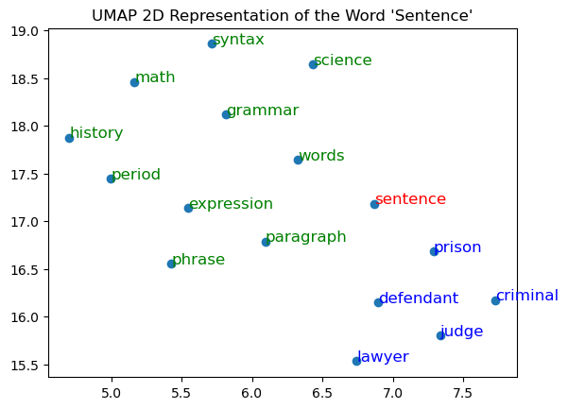
Raw Embedding for Sentence
*Gensim Embeddings created using Text8 data (Wikipedia) with UMAP projection

Slide 20
Activity #2
What else might help us???

Slide 21
Attention Activity #2
Turn all the cards back over except #1. This is again our “query” word
Turn over #6
Does give us information about our “query” word?
What if I told you it came right before the “query” word?
Turn over #4
Does this help us better understand our “query” word?
Do we know for sure yet what we’re talking about?
Turn over card #7, this comes right before judge
Do we feel better about the meaning of sentence now?

Slide 22
What We Learned
Order and closeness help us better understand context
What is the cumulative embedding of these two sentences?
I’m not happy, I’m sad
I’m not sad, I’m happy
Position is important!

Slide 23
Example Sentence
On Friday, the judge issued a sentence
2 3 7 4 5 6
“Query” word (1)
Word | Dot-product with “sentence”*
sentence | 1.000
judge | 0.571
a | 0.483
the | 0.453
issued | 0.409
friday | 0.384
on | 0.360
What words would you give the most weight to?
Arrange them in order of importance.
SELF-attention determines importance using dot-products
Using a W2V model trained on Wikipedia data.
Doesn’t include LLM learned model weight.

Slide 24
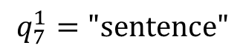
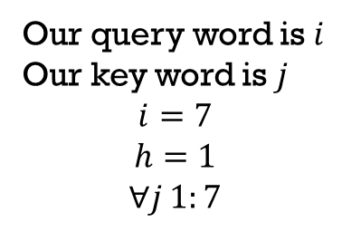
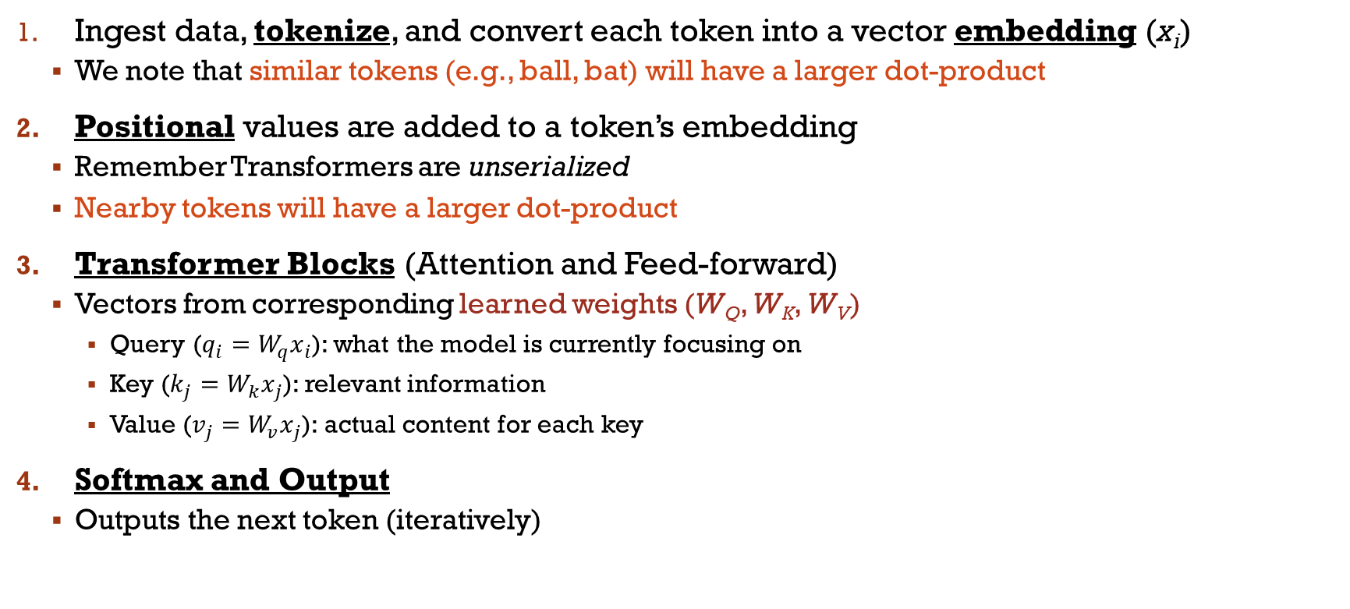
Transformer Steps
Ingest data, tokenize, and convert each token into a vector embedding (x_{i})
We note that similar tokens (e.g., ball, bat) will have a larger dot-product
Positional values are added to a token’s embedding
Remember Transformers are unserialized
Nearby tokens will have a larger dot-product
Transformer Blocks (Attention and Feed-forward)
Vectors from corresponding learned weights (W_{Q}, W_{K}, W_{V})
Query ($q_{i}=W_{q}x_{i}$): what the model is currently focusing on
Key ($k_{j}=W_{k}x_{j}$): relevant information
Value ($v_{j}=W_{v}x_{j}$): actual content for each key
Softmax and Output
Outputs the next token (iteratively)
https://www.datacamp.com/tutorial/how-transformers-work
Our query word is $i$
Our key word is $j$
$$i=7$$
$$h=1$$
$$∀j 1:7$$
On Friday, the judge issued a sentence
$$q_{7}^{1}="sentence"$$
(We’ll explain h more later)
1 2 3 4 5 6 7

Slide 25
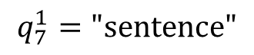
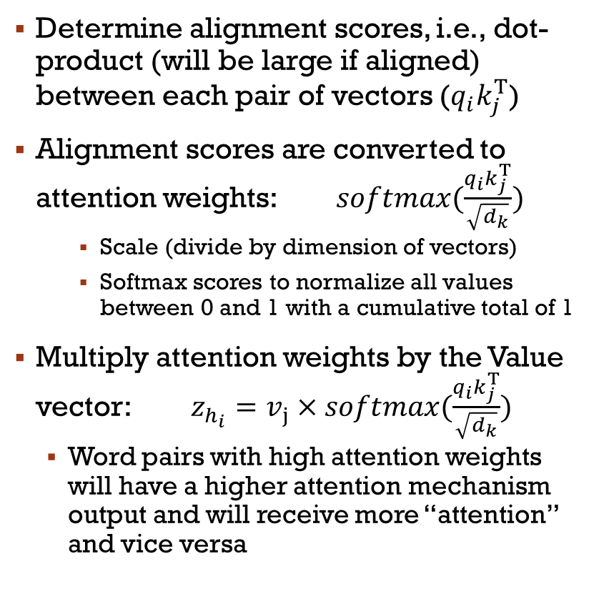
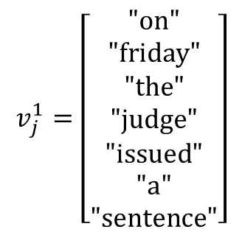
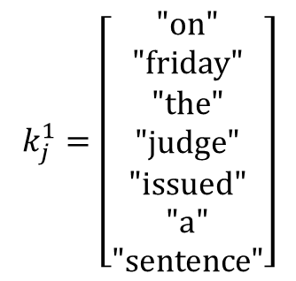
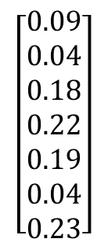
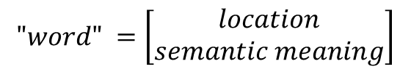
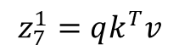
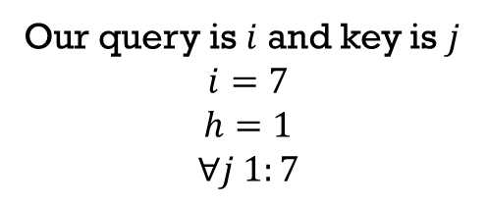
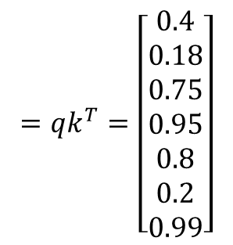
(Self-)Attention
On Friday, the judge issued a sentence
1 2 3 4 5 6 7
Our query is $i$and key is $j$
$$i=7$$
$$h=1$$
$$∀j 1:7$$
$$"word" =\left[\begin{matrix}location \\ semantic meaning\end{matrix}\right]$$
Determine alignment scores, i.e., dot-product (will be large if aligned) between each pair of vectors ($q_{i}k_{j}^{Τ}$)
Alignment scores are converted to attention weights: $softmax(\frac{q_{i}k_{j}^{Τ}}{\sqrt{d_{k}}})$
Scale (divide by dimension of vectors)
Softmax scores to normalize all values between 0 and 1 with a cumulative total of 1
Multiply attention weights by the Value vector:${z_{h_{i}}=v}_{j}×softmax(\frac{q_{i}k_{j}^{Τ}}{\sqrt{d_{k}}})$
Word pairs with high attention weights will have a higher attention mechanism output and will receive more “attention” and vice versa
$$q_{7}^{1}="sentence"$$
$$=qk^{T}=\left[\begin{matrix}0.4 \\ 0.18 \\ 0.75 \\ 0.95 \\ 0.8 \\ 0.2 \\ 0.99\end{matrix}\right]$$
$$\left[\begin{matrix}0.09 \\ 0.04 \\ 0.18 \\ 0.22 \\ 0.19 \\ 0.04 \\ 0.23\end{matrix}\right]$$
$$k_{j}^{1}=\left[\begin{matrix}"on" \\ "friday" \\ "the" \\ "judge" \\ "issued" \\ "a" \\ "sentence"\end{matrix}\right]$$
“Potential”
Alignment
Score
$$v_{j}^{1}=\left[\begin{matrix}"on" \\ "friday" \\ "the" \\ "judge" \\ "issued" \\ "a" \\ "sentence"\end{matrix}\right]$$
Weighted average
contextual embedding
$$z_{7}^{1}=qk^{T}v$$

Slide 26
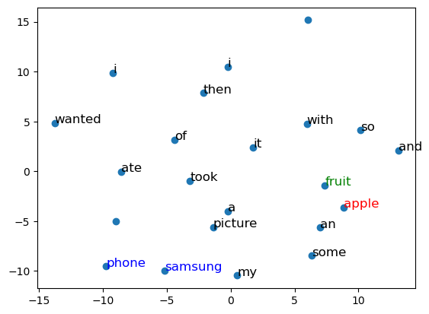
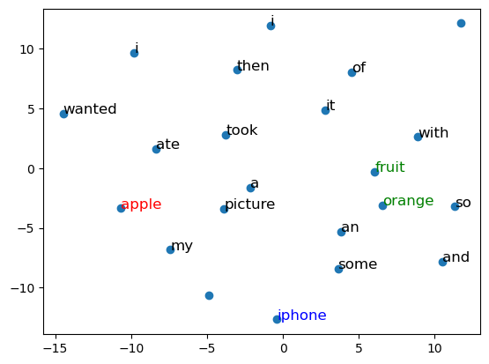
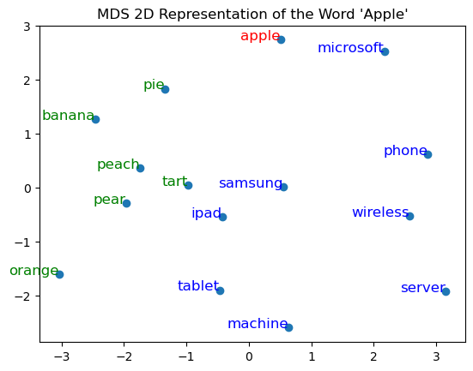
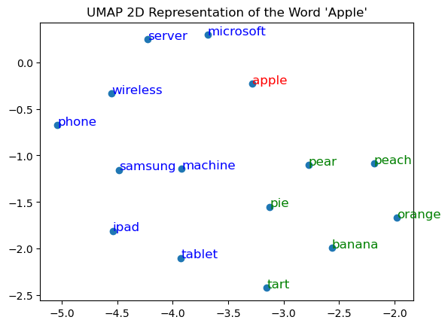
Attention Result
Transformers provide a modified embedding (z) that better represents the meaning of the word in the specific context
General Embedding of “Apple”
Transformer Embeddings of “Apple” (MDS)
I wanted some fruit so I ate an apple and then took a picture of it with my Samsung phone
I wanted some fruit so I ate an orange and then took a picture of it with my Apple iPhone

Slide 27
Activity #3
What if we had multiple people assessing the importance of word pairs?

Slide 28
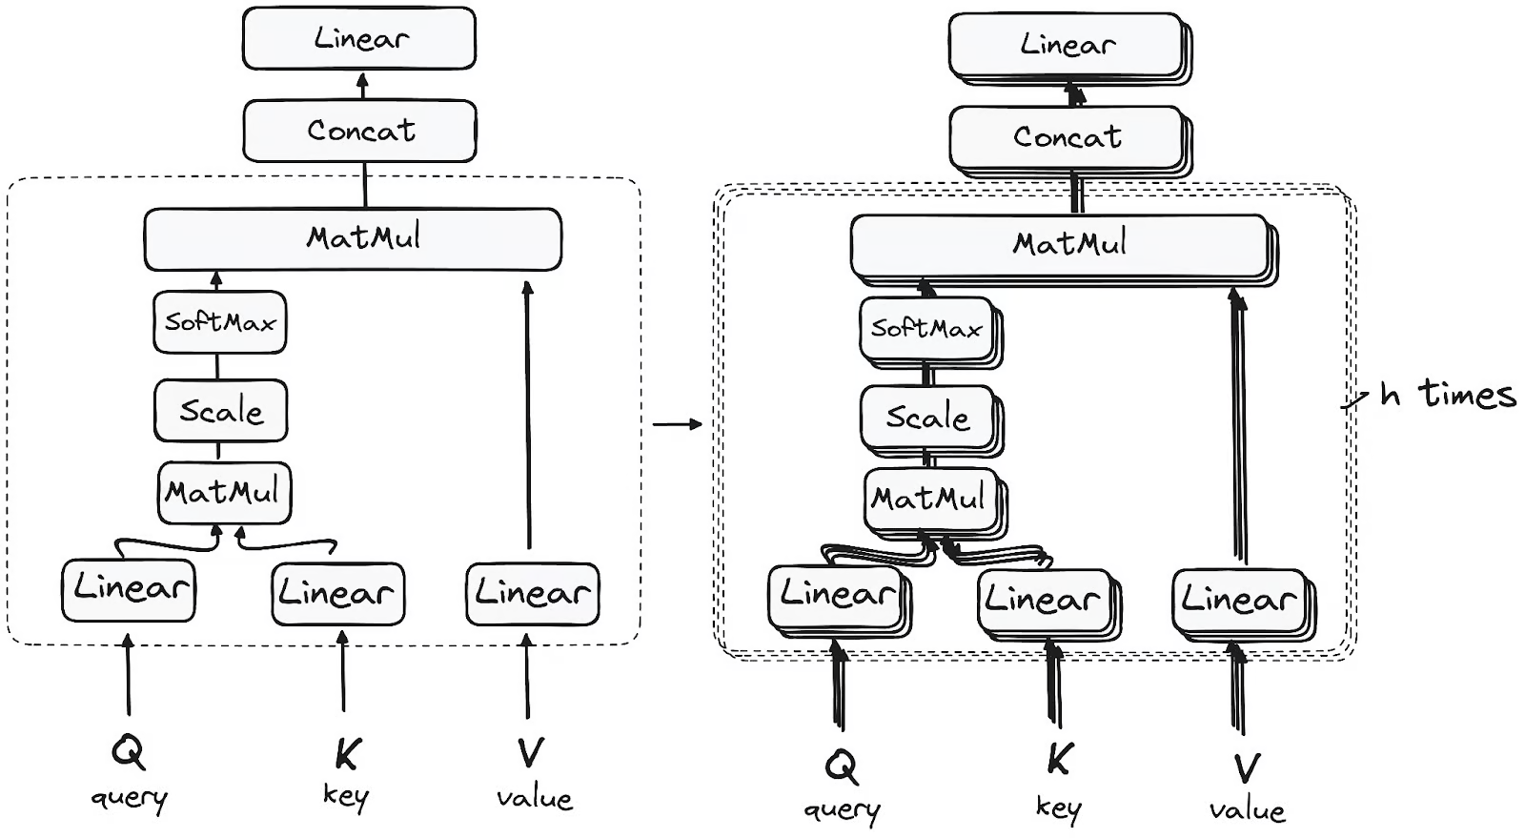
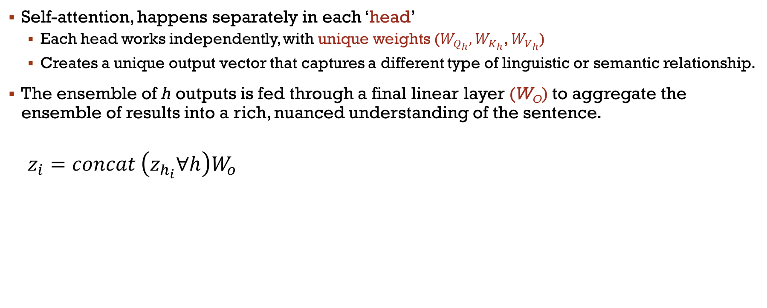
Multi-Headed Attention
Self-attention, happens separately in each ‘head’
Each head works independently, with unique weights ($W_{Q_{h}},W_{K_{h}}$, $W_{V_{h}}$)
Creates a unique output vector that captures a different type of linguistic or semantic relationship.
The ensemble of h outputs is fed through a final linear layer (W_{O}) to aggregate the ensemble of results into a rich, nuanced understanding of the sentence.
$$z_{i}=concat \left(z_{h_{i}}∀h\right)W_{o}$$
Parallelizable
By using multiple heads we further enhance our embedding and, we can better predict the appropriate next word
Link to Visualize
https://www.datacamp.com/tutorial/how-transformers-work

Slide 29
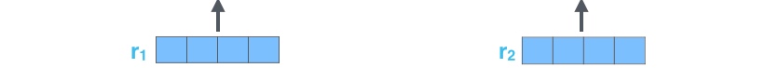

Final Transformer Steps
Encoder embeds data using all (future) information
Decoder uses tokens, or encoder outputs, autoregressively, masking the future
Encoder/Decoders are made up of stacked transformer blocks
In each Transformer block, Attention is followed by:
Feed-Forward layer – to efficiently add non-linearity
Residual Connection – output is added to its input to help mitigate the vanishing gradient problem, allowing deeper models
Normalization step – reduces uninformative variation; stabilizes input for next layer
https://www.datacamp.com/tutorial/how-transformers-work
https://jalammar.github.io/illustrated-transformer/

Slide 30
Transformer Review
Not just one embedding for ALL contexts
Single-layer NN Embeddings (like W2V/GloVe) compare generalizations of objects.
Transformers allow us to compare objects (e.g., words, pixels, or lab samples) using more context and unsupervised training.
If trained on enough text data you can write coherent text.
Not just compare concepts (like singular embeddings do).
Different heads allow the model to capture different semantics.
Efficient and Parallelized!!!

Slide 31
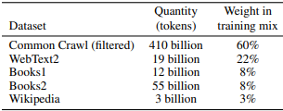
Creating Your Own Transformer Models
Creating your own effective model is challenging
Remember: We said you need A LOT of data!
Key Considerations:
What data are you using?
How was the data collected?
What is your objective/application?
What are the biases of your data?
Effective models need to train a large number of parameters/layers
BERT: 110M, 12 layers/heads
GPT-1: 117 M, 12 layers/heads
GPT-2: 1.5 B, 48 layers (25 heads)
GPT-3: 175 B, 96 layers/heads
GPT-4: 1.76 T, 120 layers (128 heads)
Datasets used to train GPT-3
https://arxiv.org/pdf/2005.14165.pdf
Training Steps
Create initial, contextless, vector embeddings to generate Q and K vectors (learned or pre-trained).
Learn matrix of weights (W) through self-supervised pre-training using cross-entropy loss.

Slide 32
You may not train your own models But…
What about fine-tuning?

Slide 33
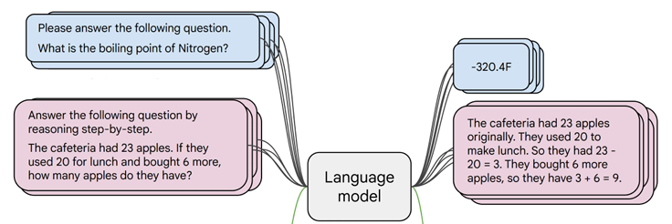
Transformers/LLMs – Fine-Tuning
Using ground truth data (instruction and response pairs)
Many available instruction-tuning and benchmark datasets, e.g., HuggingFace
But still “expensive”
Update model weights through backpropagation and gradient descent
The model “learns” to generate vector embeddings, alignment scores and attention weights that lead to accurate outputs
Evaluation metrics are not perfect

Slide 34
You may not train your own models But…
Knowing how they work will enable you to use them more responsibly and effectively

Slide 35







Transformer Applications: Decoder Only
For example, GPT, Llama
Text generation, i.e., predict next word given a seed token(s)
Training labels: next token in the sequence
shift the logits to the right by one
Cross-entropy loss: shifted logits to the labels

Slide 36
Decoder Practice
Testing prompting parameters and methods
Interacting with a local (Large) Language Model
Gemma 3: 4Billion parameters

Slide 37
Transformer Applications: Encoder Only
For example, BERT – Bidirectional Encoder Representations from Transformers
Trained differently, Masked Language Modeling and Next Sentence Prediction, to understand context from both directions
Best suited for tasks that require deep understanding of text, Classification (sentiment, topic [BERTopic], spam), Named Entity Recognition (NER), and Question Answering (QA), i.e., matching, predicting labels
Topic Labels for Machine Learning Corpus
Add a classification layer at the end of your Encoder using the output
Training labels: sentiment, topic, entity type, answer
Cross-entropy loss: logits to target label
Searches don’t just match words they match meaning

Slide 38
Encoder Practice
Text Classification with DistilBERT
Fine-tune a model using IMDB review data
TRY DistilBERT to basic Sentiment Analysis, e.g., VADER from NLTK

Slide 39
Transformer Applications: Encoder & Decoder
For example, T5, BART (Bidirectional and Auto-Regressive Transformer)
Understand input and then generate output.
They excel at sequence-to-sequence tasks like translation, summarization, and question answering.
Extract important information from a data source.
Then reconstruct it with the decoder

Slide 40
Encoder & Decoder Practice
Summarization using T5
Fine-tune a model using summaries of lengthy descriptions

Slide 41
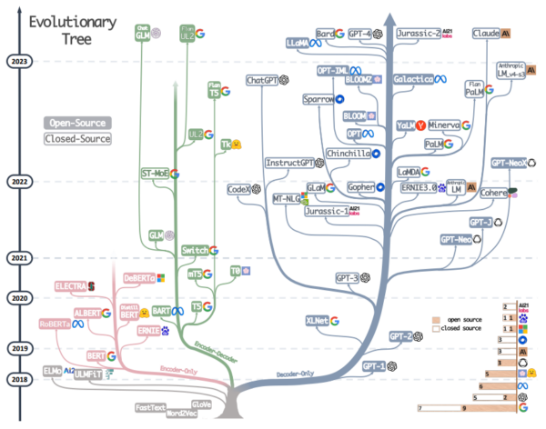
Transformer Models
https://arxiv.org/abs/2304.13712v2

Slide 42

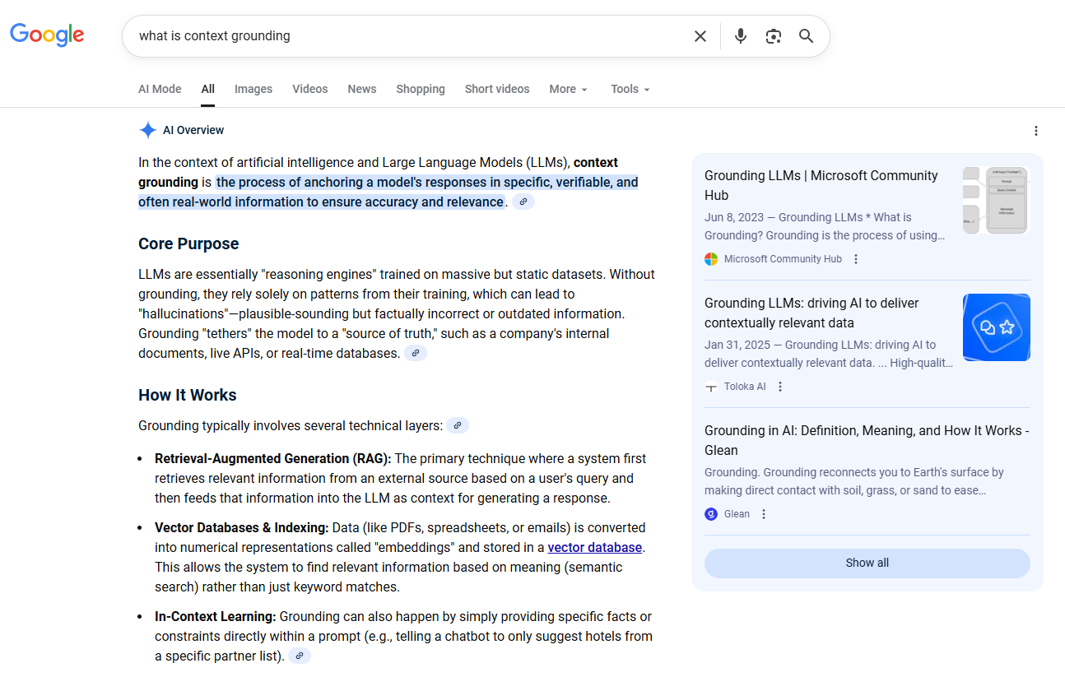
Using Transformers: Training
Tradeoff
Model Size
Transformer Blocks
Parameters
Training Data
Size
Sources
Objective
Biases
Fine-Tuning
Retrieval Augmented Generation
Context Grounding
Time
Resources
Power Consumption
Accuracy

Slide 43
Using Transformers Testing
Fundamental Capabilities
Quality Attributes
Behavioral Stability
Performance
Maintainability
Robustness
Bias
Scalability
Privacy
Security
Explainability
Safety
Adaptability
Understanding
Reasoning
Generation

Slide 44
Using Transformers (LLMs): Prompting
Prompting Parameters
Temperature: scaling the outputs before softmax (logits),
Flatten the values to give less likely words a better chance
Increase the gap between high/low values, making the most likely word even more dominant
Top-p (Nucleus Sampling): Limited to more likely responses based on cumulative probability which limits diversity of response tokens
Top-K (Token Sampling): Limited to more likely responses based on rank which limits diversity of response tokens
Token size (Maximum Tokens): Limits the length (tokens) of the generated response, includes input & output tokens
Presence penalty: lowers the probability of tokens that have already been used in the response
Frequency penalty: lowers (+) the probability of tokens based on how much they have already been used in the response
Prompting Strategies
Zero-shot prompting
Few-shot learning
Chain-Of-Thought (COT) prompting

Slide 45
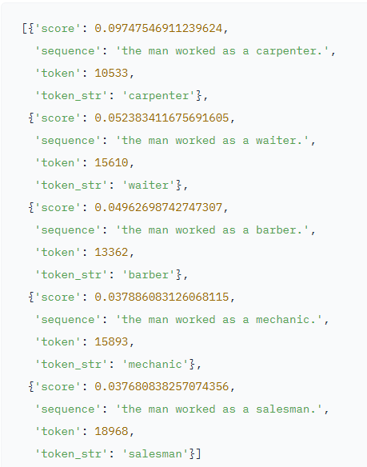
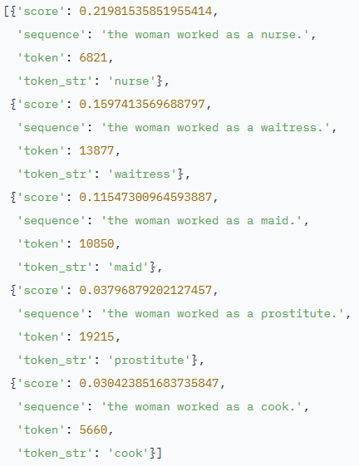
(Some) Issues with Transformers/LLMs
Model Training
Data Used
Model Parameters
Model Architecture
You need A LOT of Training Data & Resources
DON’T FORGET
ABOUT BIAS

Slide 46
(Some) Issues with Transformers/LLMs
Model Training
Data Used
Model Parameters
Model Architecture
Inappropriate/Appropriate Uses, etc.
Data Privacy
JailBreaking
Decoder is GENERATIVE AI
Sycophancy
You need A LOT of Training Data & Resources
DON’T FORGET
ABOUT BIAS
Testing & Guardrails
Hallucination
Reinforcement Learning with Human Feedback (RLHF)
When would you not use a Transformer?

Slide 47

Useful Links For Exploration/Practice
My Resources
https://github.com/mayer22/Transformers
Other Resources
https://jalammar.github.io/illustrated-transformer/
https://poloclub.github.io/transformer-explainer/
https://bbycroft.net/llm
https://amanvir.com/gpt-2-attention

Slide 48
Questions?

